Slide 1
BadPacket study
Hidemitsu Asano

Slide 3
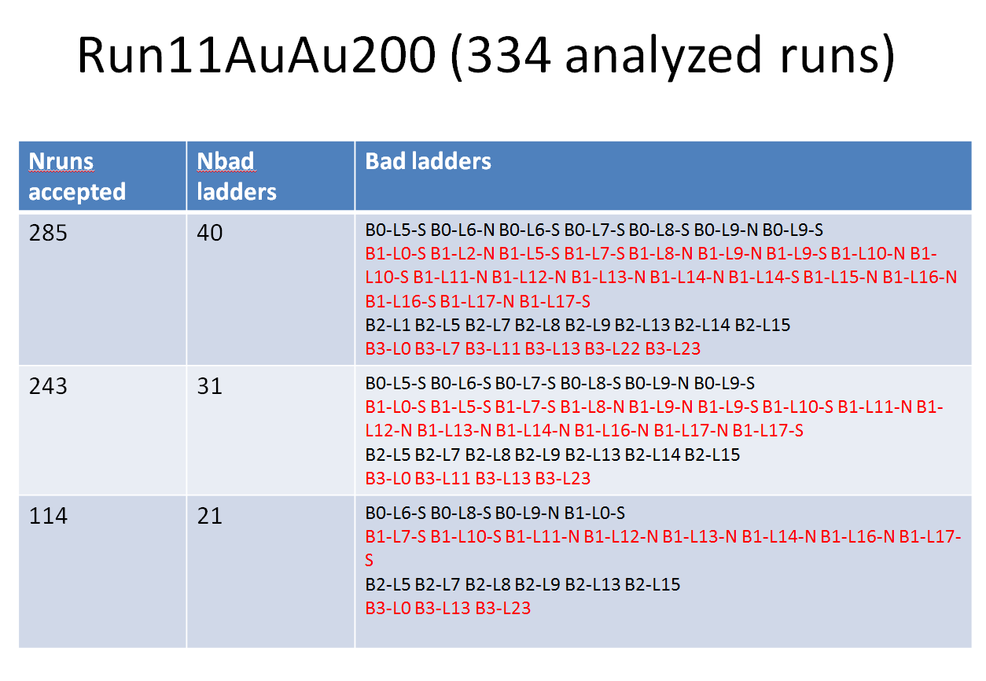
from John Koster’s slide
before QM, 3rd group (tightest one) was used for analysis.

Slide 4
BadPacket events in Run11 AuAu 200GeV
As Takashi reported last week, we are studying why Event Killer killed ~50% event in QM analysis.
scanned EventHeader node in compactCNT.

Slide 5
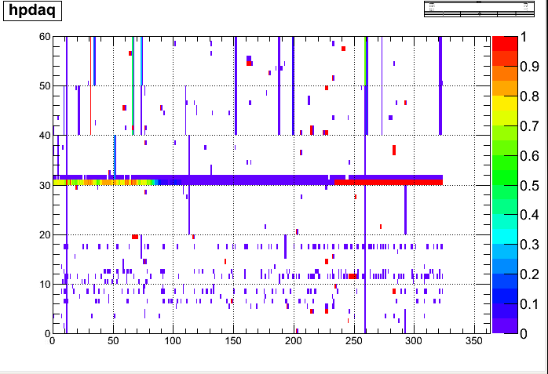
pixel badpacket fraction for each run
module ID
irun

Slide 6
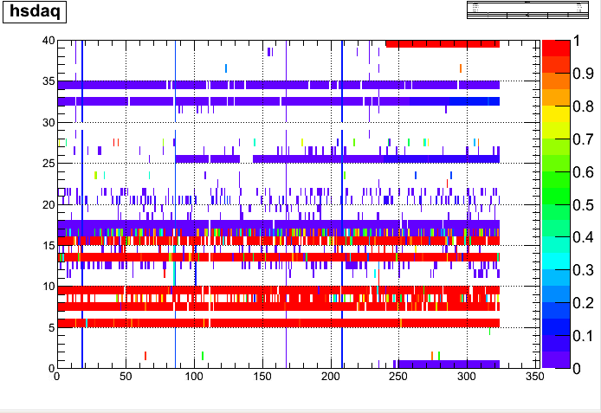
stripixel badpacket fraction for each run
module ID
irun

Slide 7
pixel bad packet fraction (after 4th repair)
# of bad packet /event
pixel module ID

Slide 8
stripixel bad packet fraction (after 4th repair)
# of bad packet /event
stripixel module ID

Slide 9
backup

