Slide 1
stability
Hidemitsu Asano

Slide 2
pixel unstable point
seg#

Slide 3
seg#

Slide 4
stripixel unstable point
seg#

Slide 5
seg#

Slide 6
Strawman plan
by using QA histograms
(They were produced during run11 AuAu 200 GeV production)
calculated # of cluster/events
pixel: chip by chip
stripixel : ?
flag for
- drop
- increase
-その他の挙動
New database table for “unstable flag” .
hot dead map database is not changed by this study
These unstable flag will be used for
RP(VTX) modules
cluster, tracking ...(?)

Slide 7
documentation
-svx geometry
https://www.phenix.bnl.gov/WWW/offline/wikioff/index.php/SVX_Geometry
-offset calibration
https://www.phenix.bnl.gov/WWW/offline/wikioff/index.php/Coordinate_offset_calibration
-beam center calibration
https://www.phenix.bnl.gov/WWW/offline/wikioff/index.php/Beam_center_calibration

Slide 8
/direct/phenix+zdata04/phnxreco/run12pp510/1206

Slide 9
backup

Slide 10
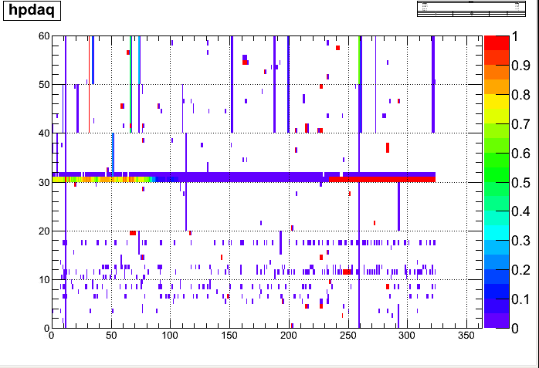
pixel badpacket fraction for each run
module ID
irun

Slide 11
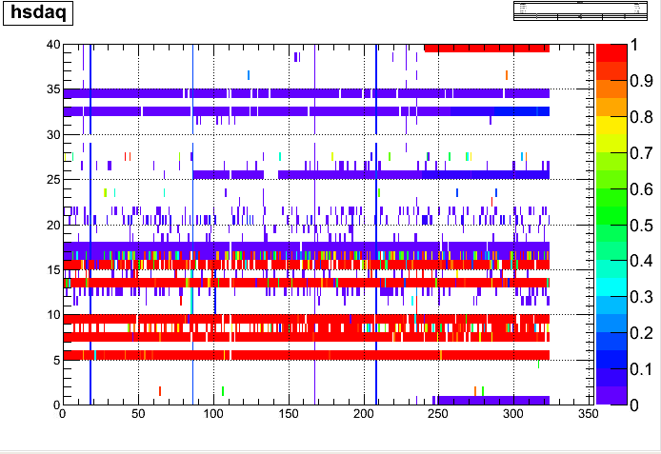
stripixel badpacket fraction for each run
module ID
irun

Slide 12
pixel bad packet fraction (after 4th repair)
# of bad packet /event
pixel module ID

Slide 13
stripixel bad packet fraction (after 4th repair)
# of bad packet /event
stripixel module ID

Slide 14
VTX stability study
by using QA histograms
(They were produced during run11 AuAu 200 GeV production)
calculated # of cluster/events sensor by sensor for each file segment
(update)
tuned threshold to determine the unstable sensor and scanned all data and puts “unstable flag” on unstable sensors run by run.

Slide 15
example B0L0 run347128
sensor 0
sensor 1
sensor 2
sensor 3
sensor 4
sensor 5
unstable !
pixel hit rate = (# of clusters) / (# of bbc events within +- 10cm )
stripixel hit rate = (# of clusters) / (# of bbc events within +-15cm )

Slide 16
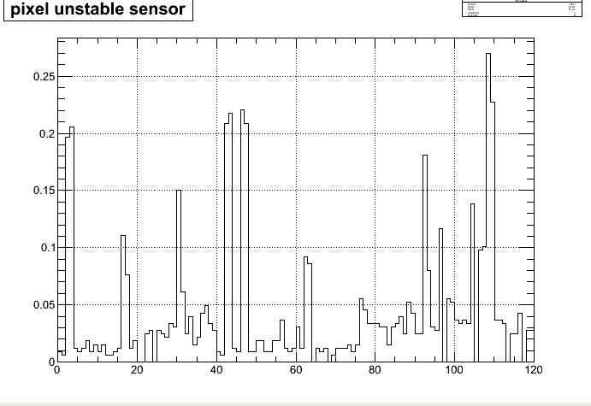
pixel unstable sensor
unstable /run
isensor
#of runs : 326

Slide 17
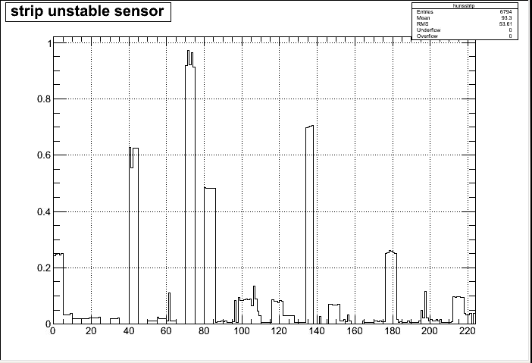
stripixel unstable sensor
unstable /run
isensor
Notes:
chip 単位で見れば。 ランの終わりの方で死んだらどうする。もったいなくね？
John Koster’s study とクロスチェックしてみれば？とクリス。

Slide 18
summary & outlook
scanned QA data for after 4th repair and put “unstable flag” sensor by sensor
The result is written in text file, not database yet.
will check RP(VTX) is stable or not again for some run.
plan
New database table for “unstable flag” .
hot dead map database is not changed by this study
These unstable flag will be used for RP(VTX).

Slide 19
backup slide

Slide 20
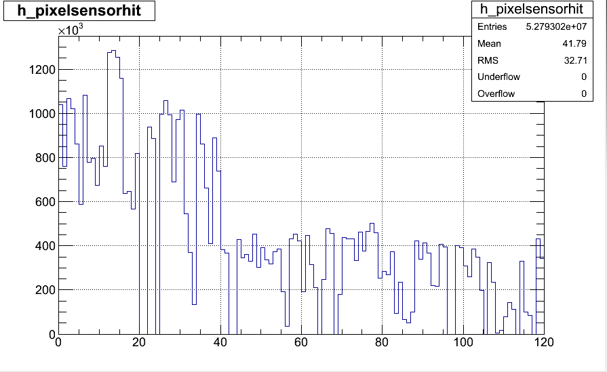
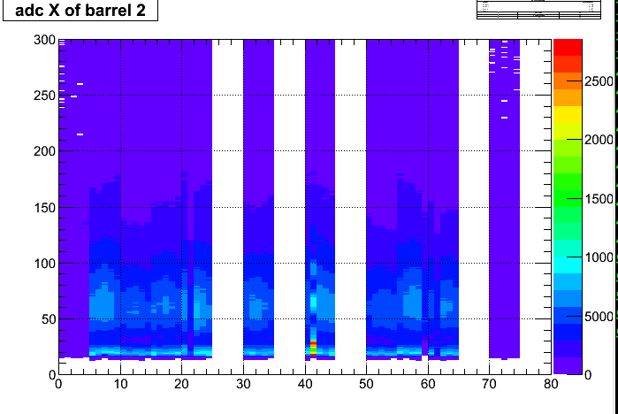
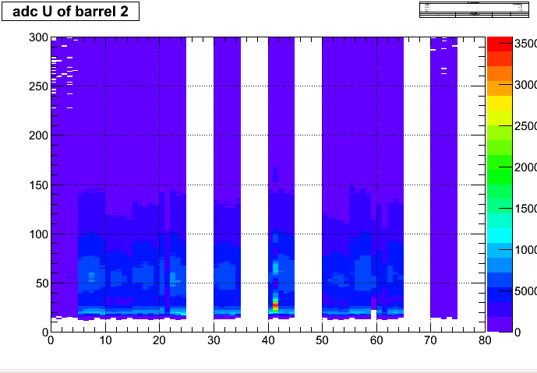
original QA outputs
-pixel
-stripixel
no z-vertex cut for those histograms.

Slide 21
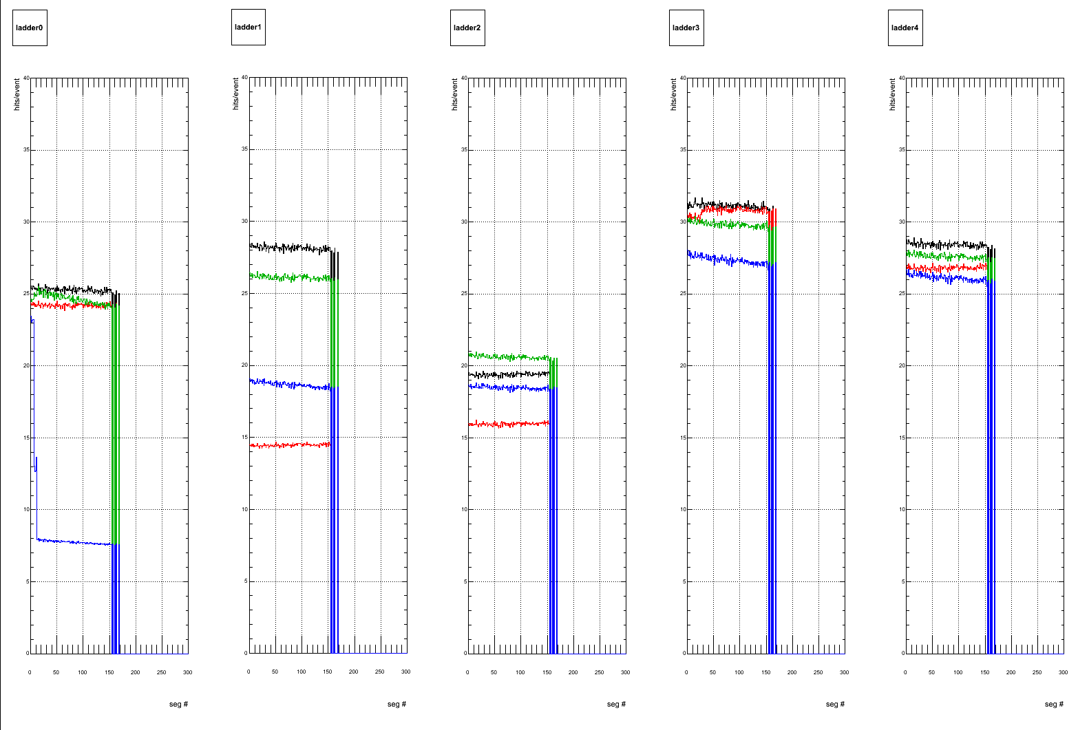
B0 west
run 347128

Slide 22
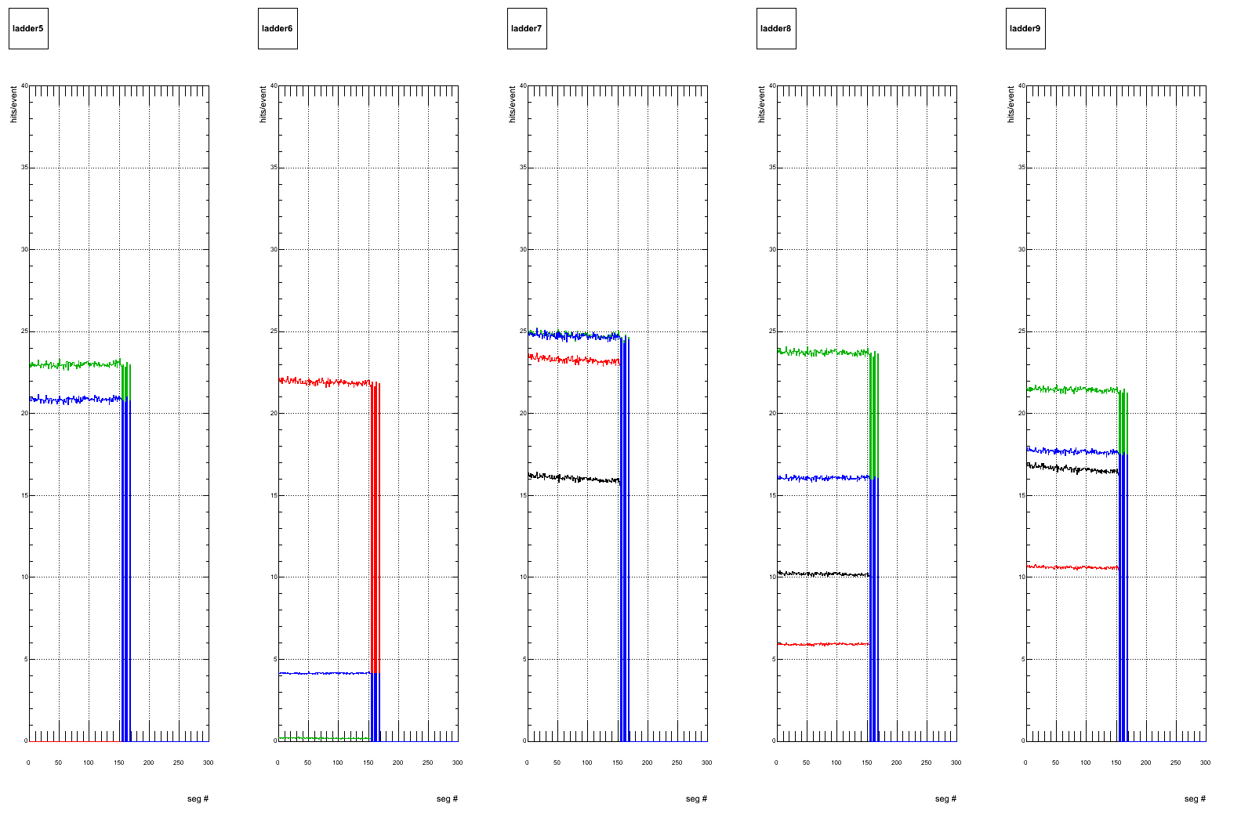
B0 east

Slide 23
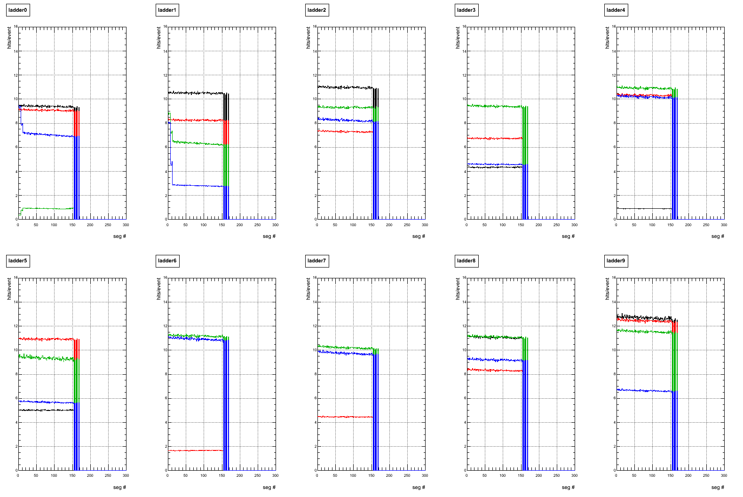
B1 west

Slide 24
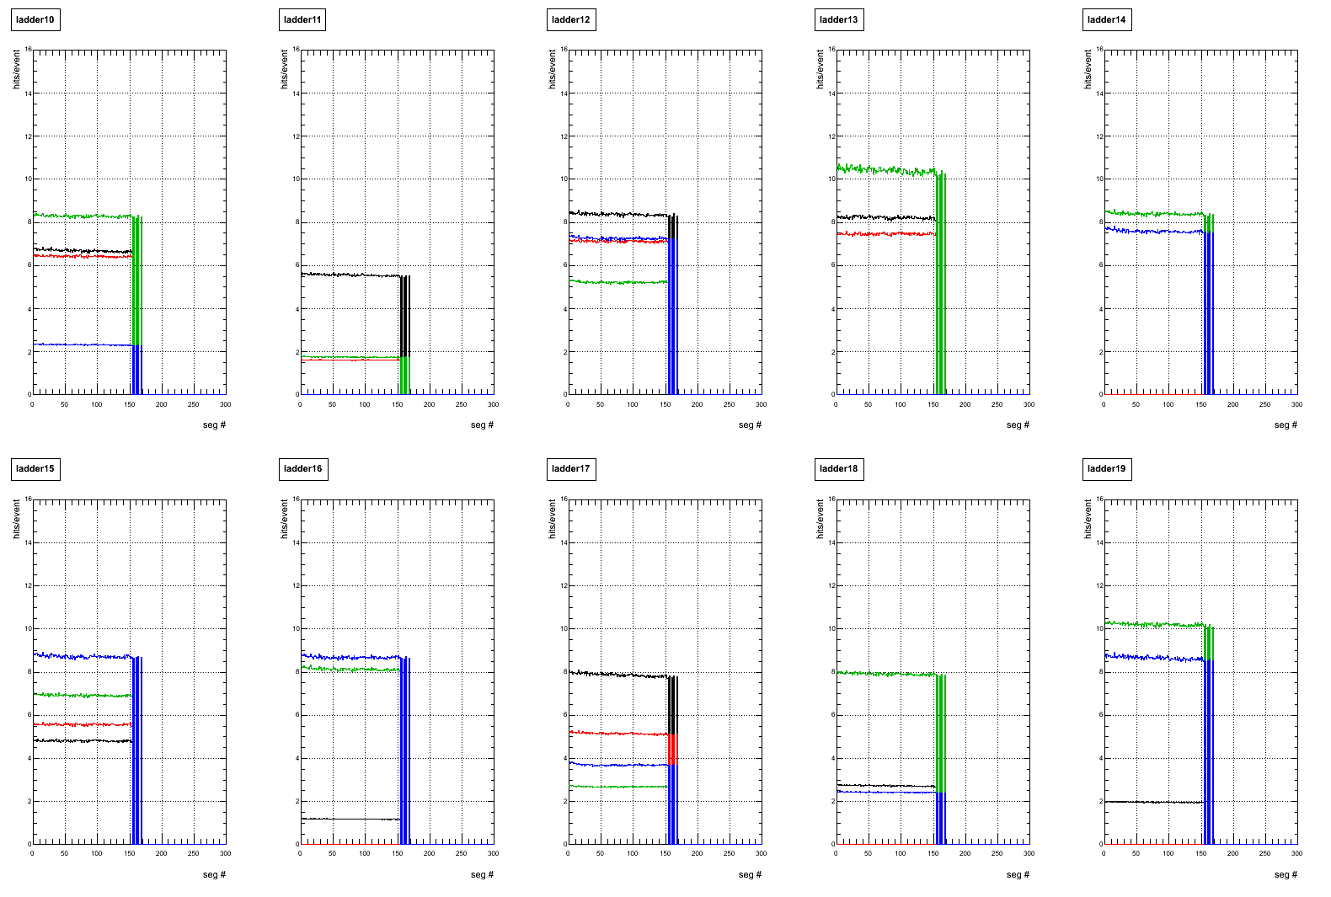
B1 east

Slide 25
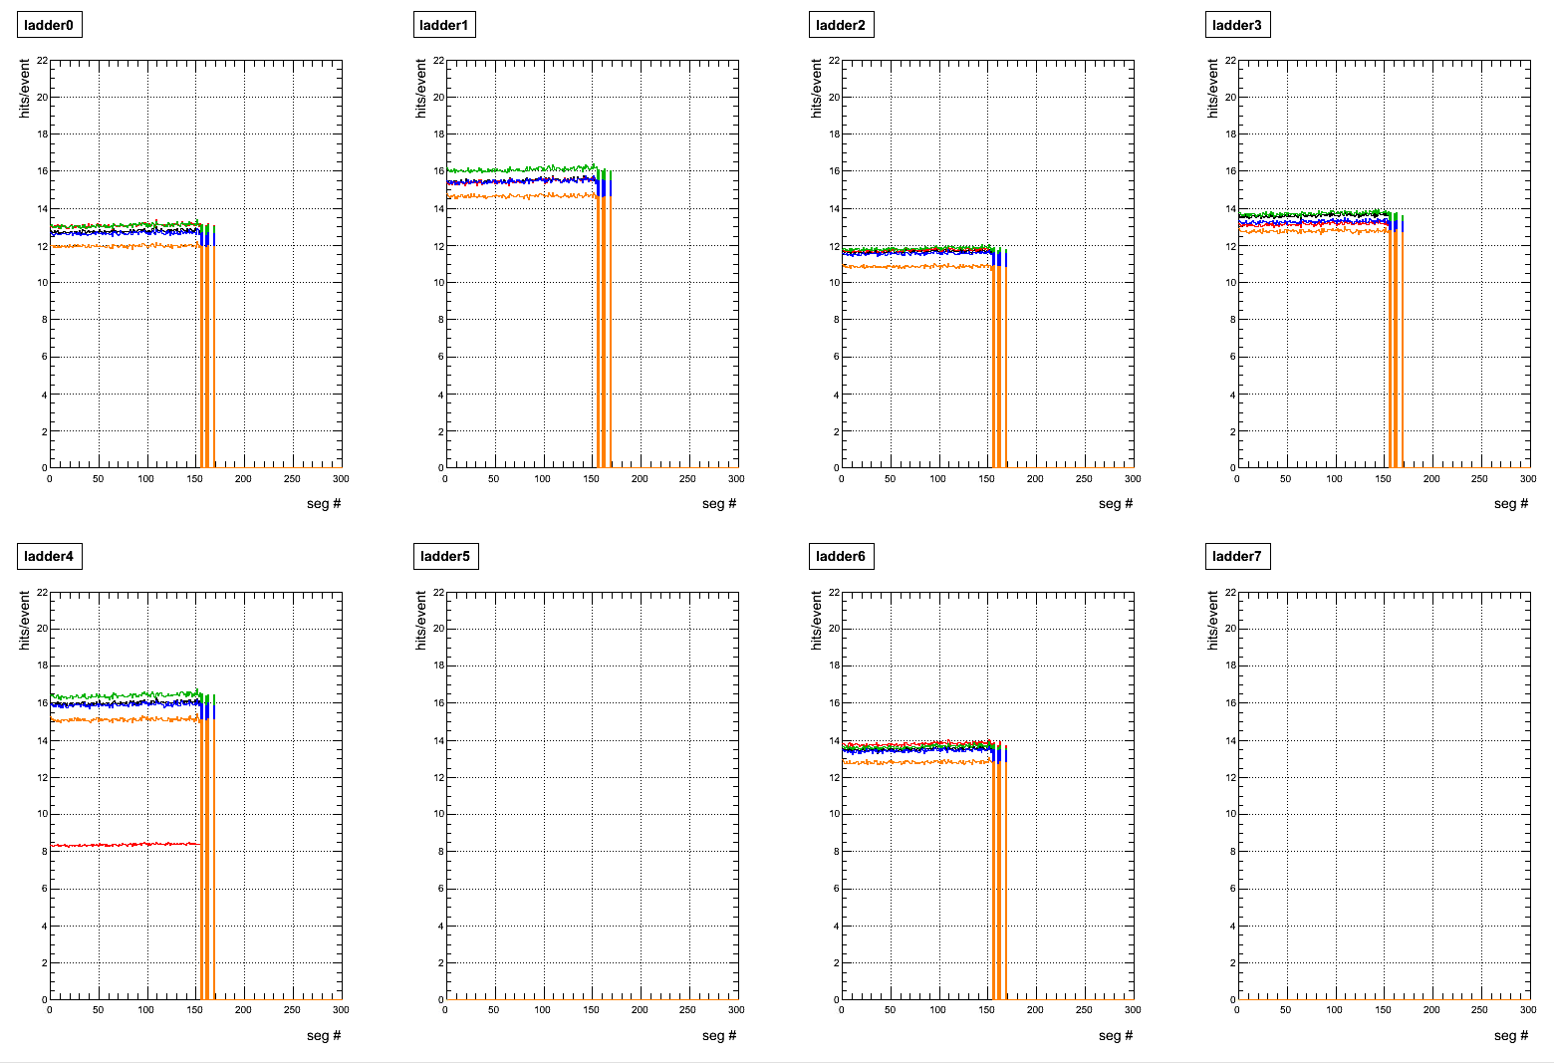
B2 west

Slide 26
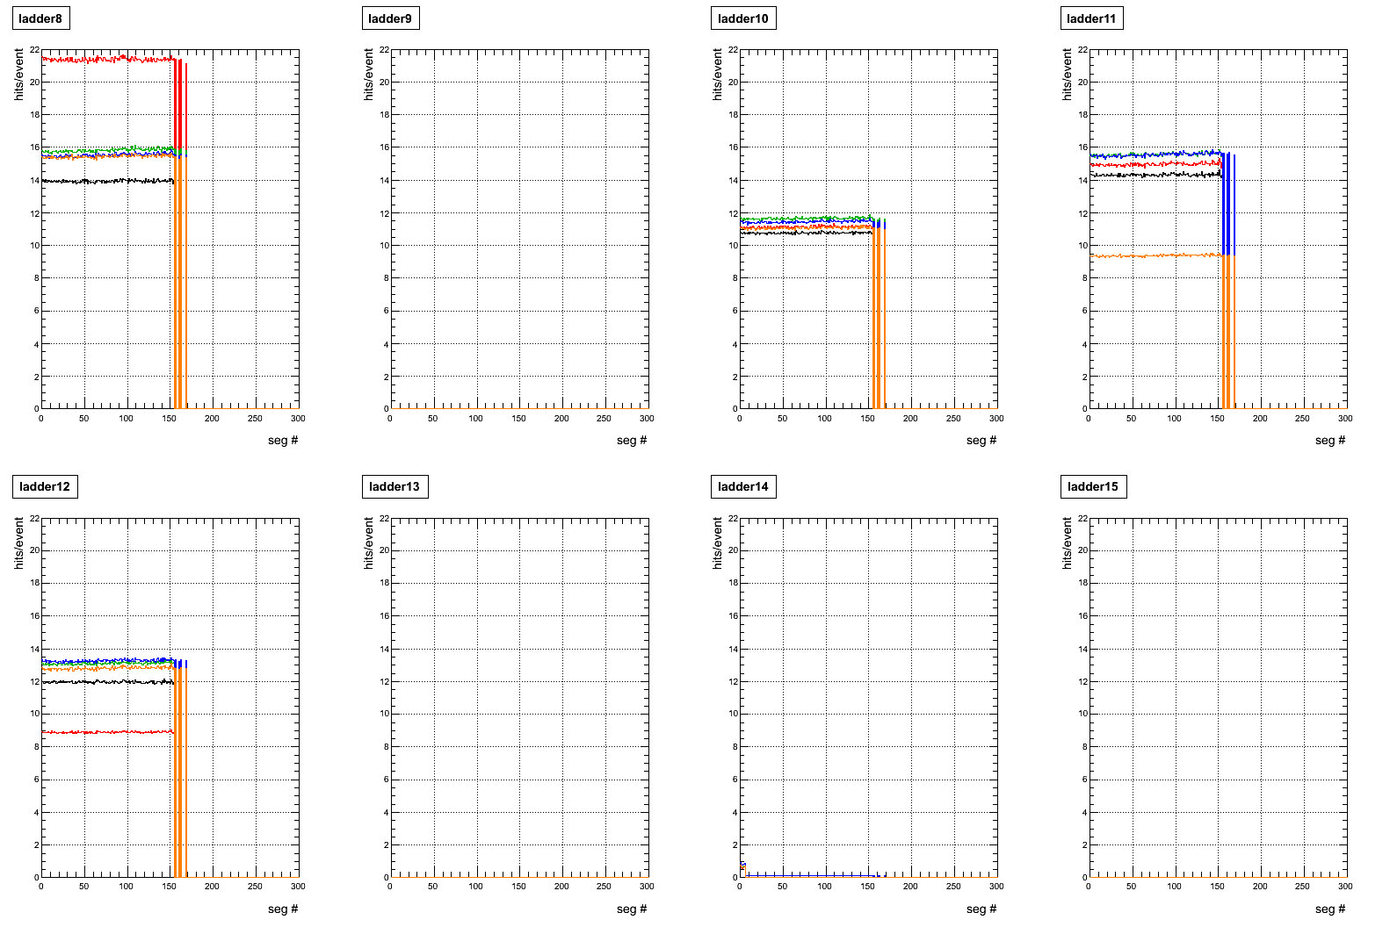
B2 east

Slide 27
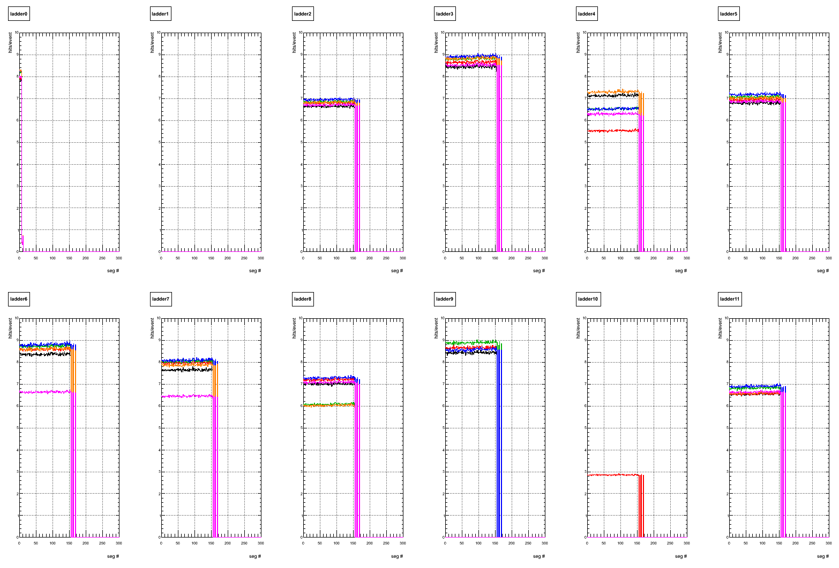
B3 west

Slide 28
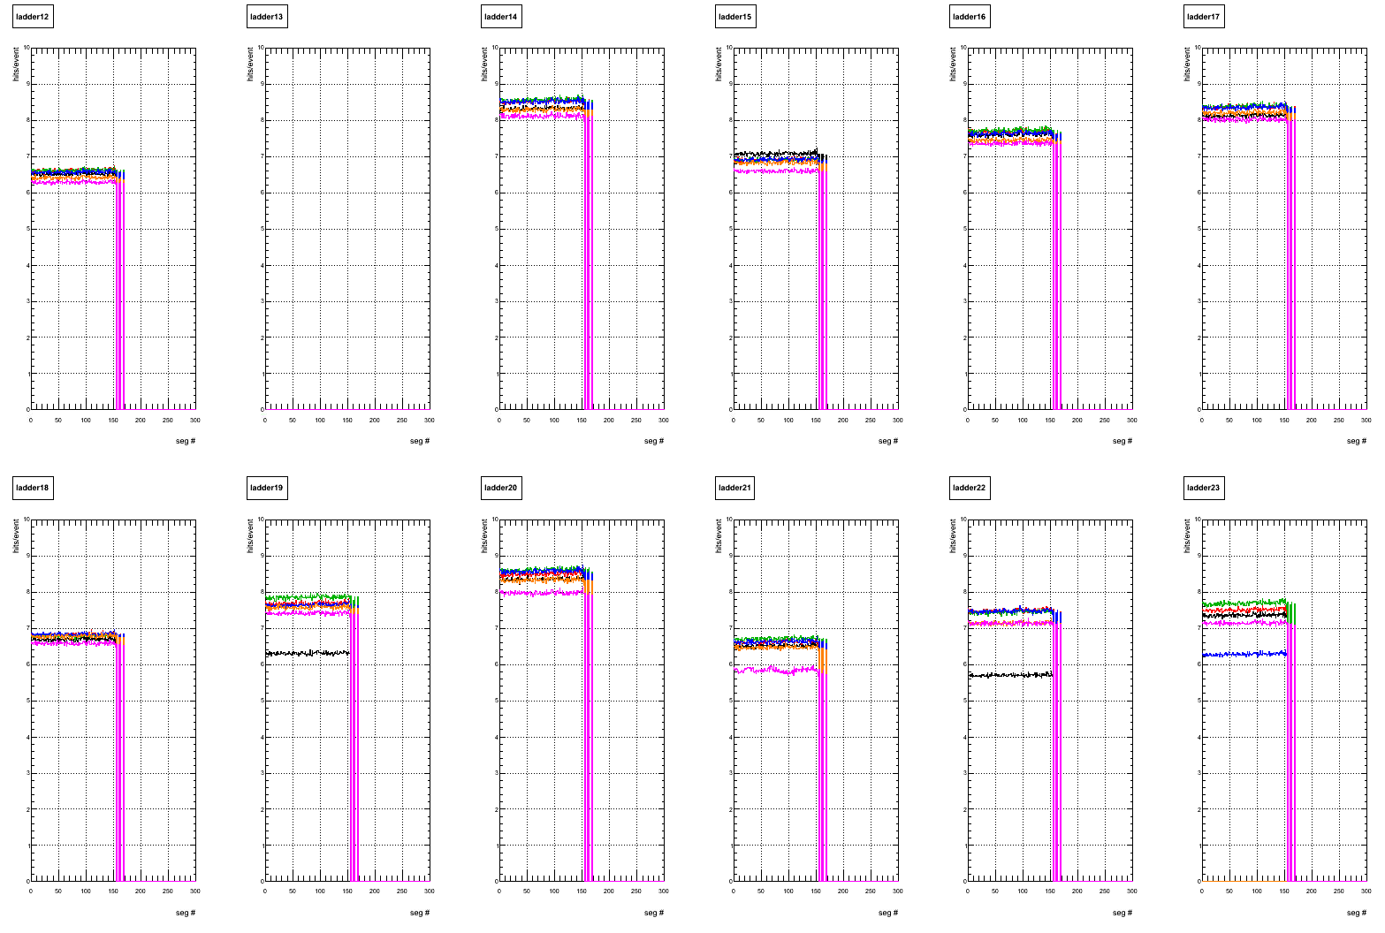
B3 east

Slide 29
unstable flag for each sensor
1. use segment # 0000 – # 0004 and calculate average hit rate sensor by sensor. (=firsthitrate)
2. scan hit rate for all segment (sensor by sensor)
if ( hit rate < 0.90*firsthitrate || 1.10*firsthitrate < hit rate )
badsegment++;
….
if(badsegment>2) the sensor is marked as “unstable”

Slide 30
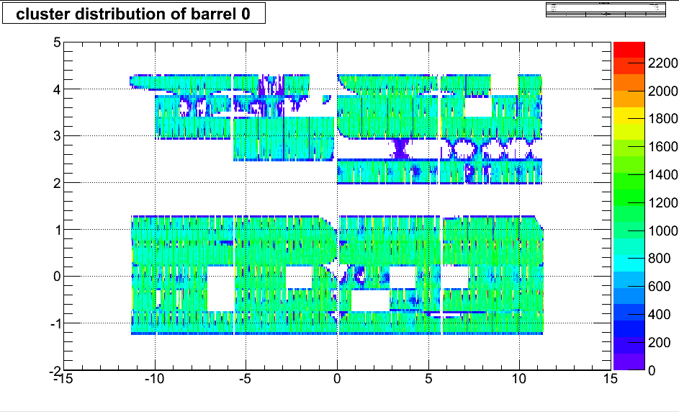
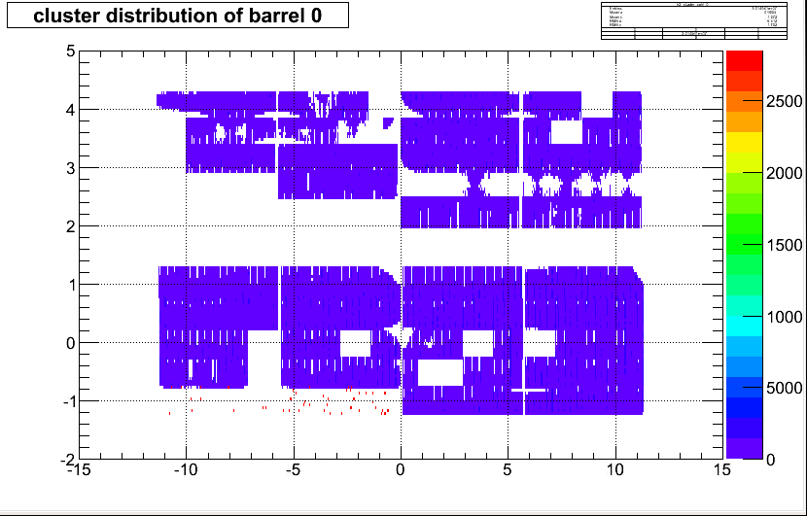
marked as unstable sensor
run 347128
phi
segment #0000
z
segment #0100

Slide 31
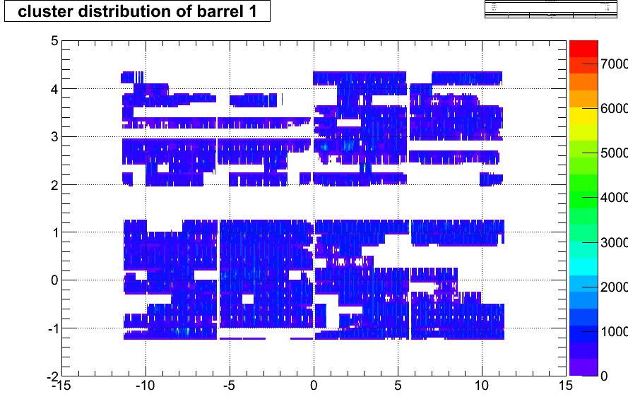
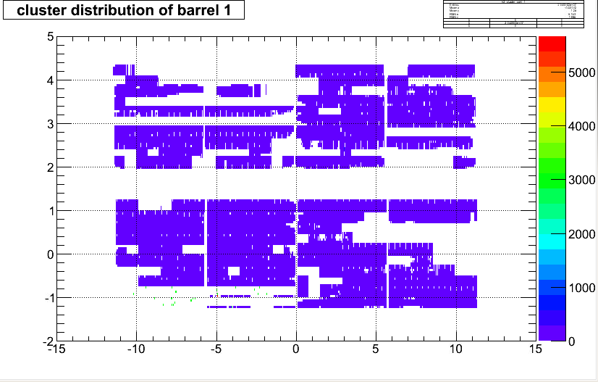
phi
z
segment #0000
segment #0100

Slide 32
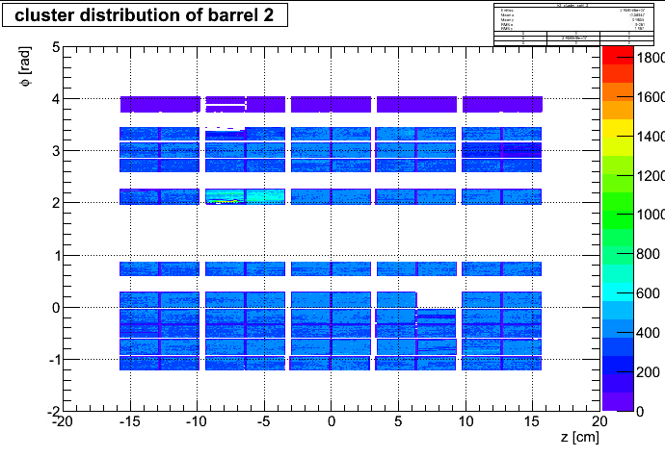
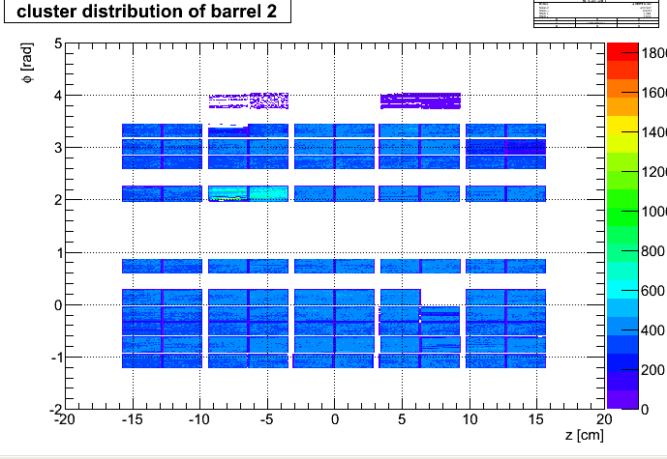
segment #0000
segment #0100

Slide 33
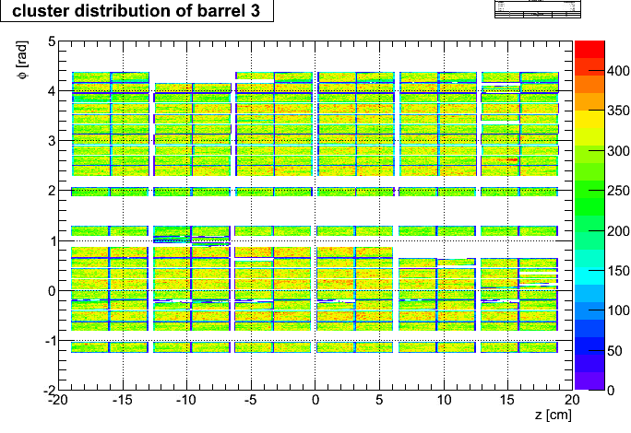
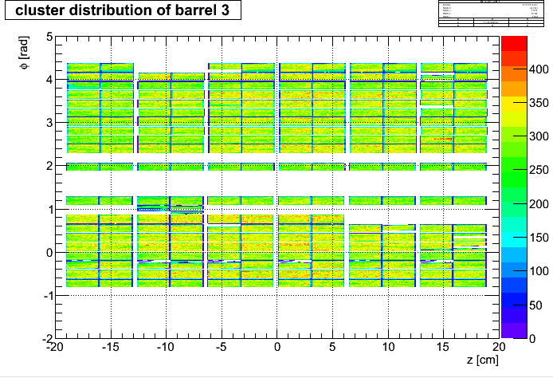
segment #0000
segment #0100

Slide 34
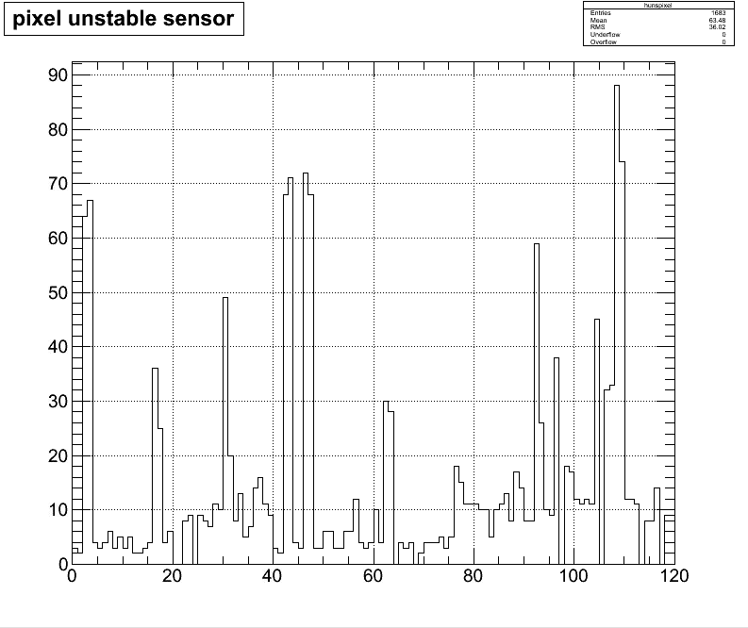

Slide 35
